Slide 1
Business Outcomes from AI
Business AI
Executive AI
Brand AI

Slide 2
Elastacloud; Data on Azure experts
Leading UK Data and Azure Consultancy
Based in London, Offices in Nottingham and Spain
65 Data Scientists and Data Engineers
Azure Gold Partner, Cloud Platform and Data Analytics
Open source contributors
5 MVPs; 2 Microsoft Regional Directors;
Founders UKAzure User Group
Founders IoT Innovators
Founders Inspiring Women in Data Science
Founders Cloud Infra UG
Founders Azurecraft

Slide 3
Positioning
Two types of practice:
Consultative
Value Centre
Building a practice requires:
Business Understanding
Data Understanding
Resources of Data
Tooling
Sustainable Business Processes
Value Proposition
The value of a service is greater than the cost of purchasing it and building it oneself

Slide 4
Top Business Trends
Building modular programmes to jump start solutions
Locking business and technology together
IT 2.0 – profit centre not cost centre
Many CIOs tell me they are sold on “new business models” but this turns to vapour when they try to explore it

Slide 5
The questions to answer
Opportunity discovery
What can we do?
Adoption
How do I get my company to use this?
Sustainability
How do we control costs and/or build a viable price point?
Measurement
How do we know it’s generating value?
Build
Use
Profit

Slide 6
The end goals
Providing better customer service and experience
Better products
Self-healing and self-improving
Improving operational processes and resource consumption
Faster Time to Market
Lighter Bill of Materials
New business models
Insights from data
Different pricing models

Slide 7
Agreed upon Pillars of Strategic Success
A Brand AI

Slide 8
Similarity or Uniqueness
Business problems that are similar and non-unique
If you are a software consultancy you must focus on these repeatable problems to maximise return
If you’re not a software consultancy, you must focus on the others
A rich vein of unique problems remains
Business compete on different aspects of their similar products, whether service, quality, style, sophistication, each with can be augmented with AI

Slide 9
Know your customer
What makes them proud?
Shipping reliability
Stock availability
Customer satisfaction
Product quality
These are the key KPIs of strategic success
The language of the business
Not generalisms
Growing Revenues
Controlling Costs
Reducing Risks

Slide 10
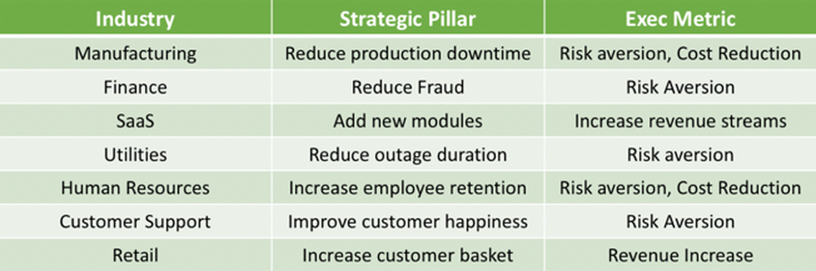
Examples

Slide 11
Mental Models
Dive deeper into strategic modelling with these mental models

Slide 12
Mental Models
In order to envision the transformation possibilities, adopt one of the following mental models. Without this, the complexity in transformation is in avoiding the bias of the achieved and conflating that with the achievable.

Slide 13
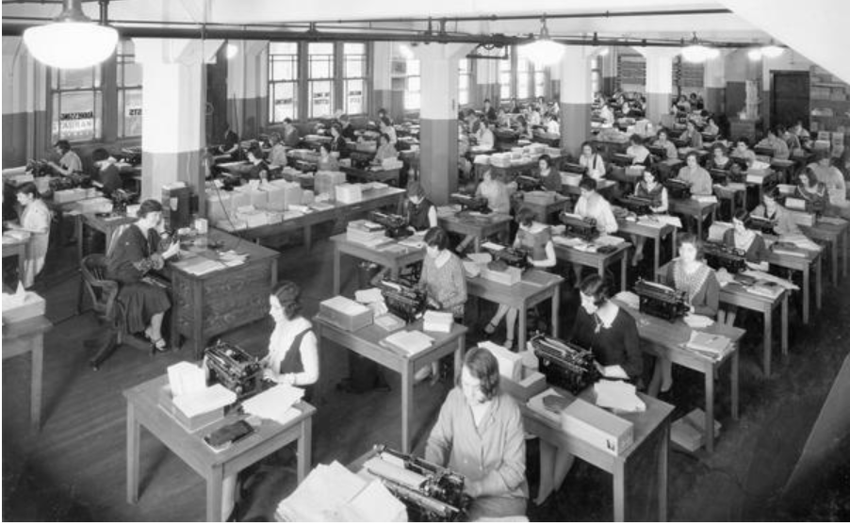
One Million Clerical Workers What is achievable with a million trained office workers?

Slide 14
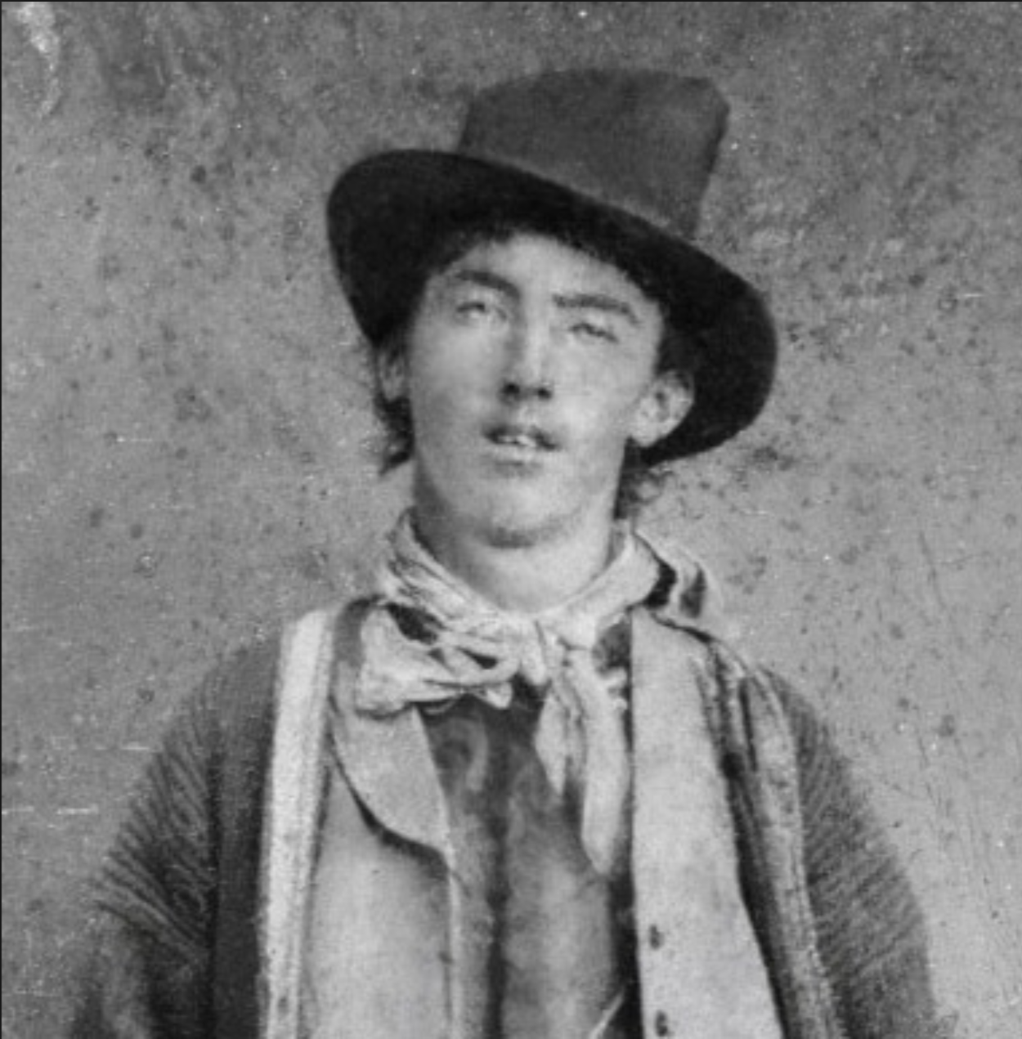
Billy the Kid Reaction Times What if all workers can react and form a course of action in 1 millisecond?

Slide 15
Auditable Actions What if all actions and their impact were measurable and qualified?
Great companies have high cultures of accountability, it comes with this culture of criticism […], and I think our culture is strong on that.
Steve Ballmer

Slide 16
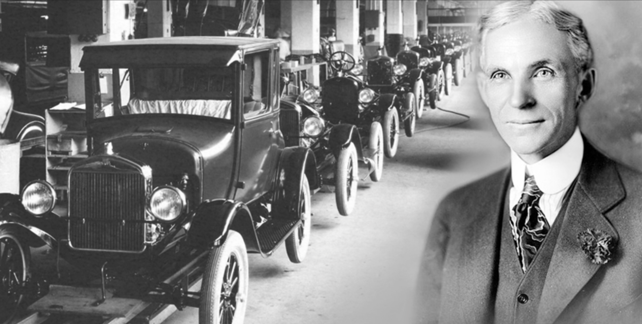
Cement the views of the Founders What if the decision making process of the hyper-successful founders was cemented and eternally referenceable?

Slide 17
All tools are Smart Tools What if every tool used by a business was as smart as a person. A forklift could tell you the context of a crate was the wrong weight. A machine could tell you it was feeling unwell. A room could tell you someone had left a dangerous tool in an unsafe state.

Slide 18
Own a Unique Selling Point [perhaps] A system that takes in all available data about a market can become a complete model for that market and can lock out competitors. Owning the most accurate model of power generation, of shoe purchasing dynamics, of stock values - prevents competitors making an entry to provide slim-services (services that complete with established businesses without the overheads of those businesses).

Slide 19
Structure

Slide 20
How to get things done in corporations?
Put the team into the swimlanes of the business
Don’t put things into a separate hived off business
SME is the most important thing

Slide 21
Lean Analytics

Slide 22
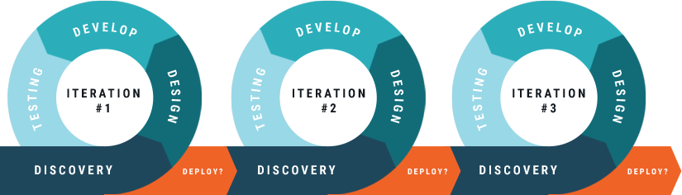
The Agile Process

Slide 23
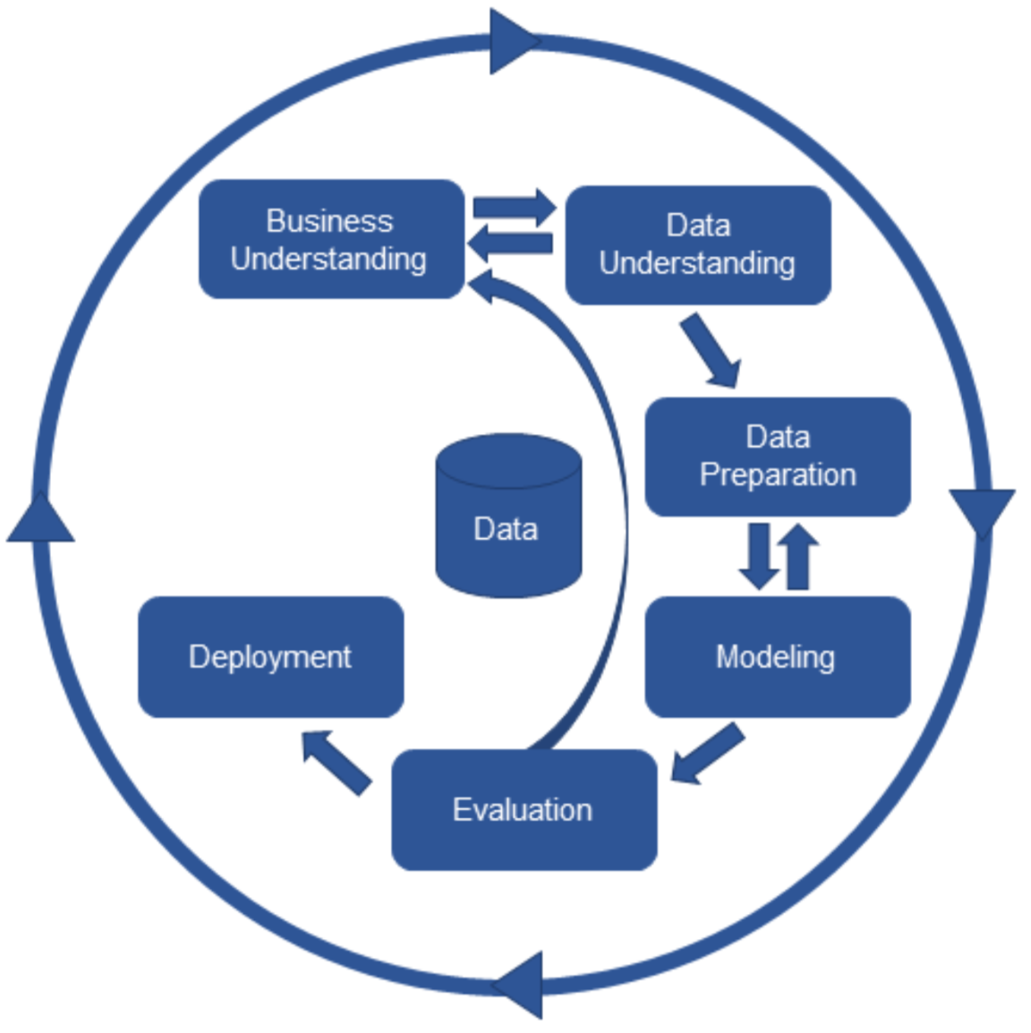
Crisp-DM

Slide 24
Building Data Products
Discover and Gather Data
Discover and Gather Data
Discover and Gather Data
Ingest Data
Ingest Data
Ingest Data
Data Understanding
Data Understanding
Business Understanding
Data Understanding
More Data Understanding
Monitor and Maintain Model
Deploy Model
Create Model
Transform Data

Slide 25
Two approaches, which one works better?
Business Understanding
Data Understanding
Data Preparation
Team Approach takes an 8 week cycle

Slide 26
Other Approach
Define Predictive model
Improve model
Improve model
Individual Approach fits into a sprint

Slide 27
Value of Data Scientists

Slide 28
When is a model good enough?
Simple answer, never!
Continuous Improvement of Platform
Software continually evolves
Better algorithms
Continuous Improvement of Model
Models continually evolve with new data
Trends, changes in behaviour need to be understood
and feature engineering needed continually

Slide 29
It works on my machine/data set!
Testing and Training
Training and Scoring
The Repeatability Problem of Data Science

Slide 30
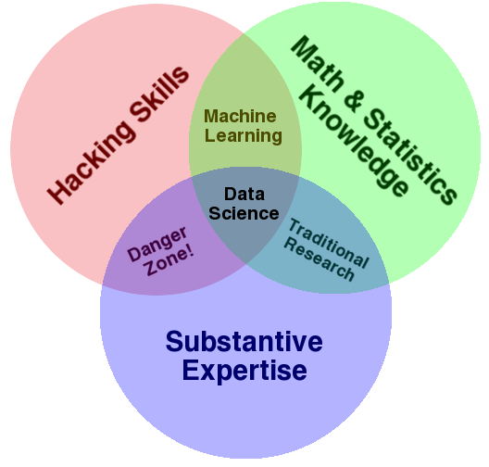
What is a Data Scientist?

Slide 31
When Data Science works
Agile practice works with continuous improvement
Data Scientists don’t handle the data impediments
Data Scientists don’t handle engineering
Data Scientists don’t handle anything other than model improvement
Easier to scale resources handle data acquisition and ETL and base format wrangling
Business can see results in increase sales, lower costs and higher efficiencies
Sit a Data Scientist with the rest of the team

Slide 32
When Data Science Projects don’t work
Things take months to years to develop
Production environments look like dev/test
Data Science becomes a model-based commodity
Everyone is too scared to talk to the Data Science team
Nobody actually knows what the team do
Business is unable to attribute any value
IT takes budgetary responsibility
Data Science “team” exists outside of SDLC

Slide 33
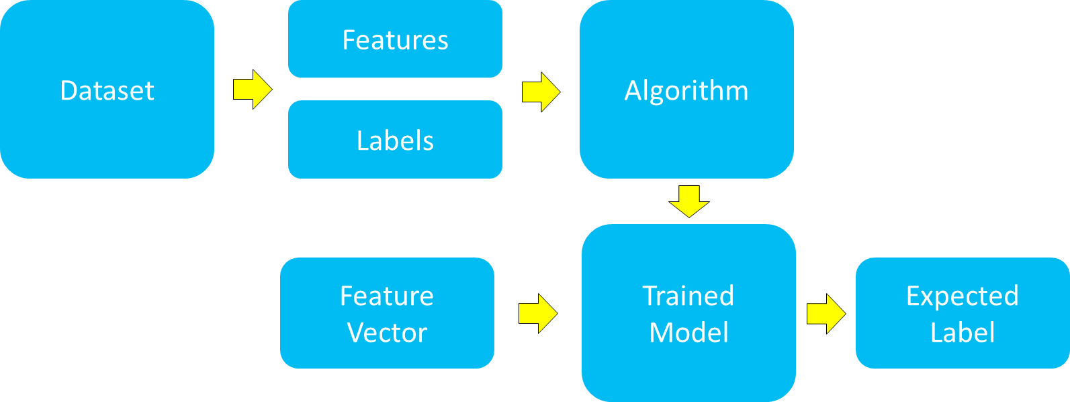
The thoughts of a Data Scientist

Slide 34
What should a Data Scientist do?
someone else
someone else
Data Acquisition
Data Preparation
Feature Engineering
Modelling
Evaluation
Blah, blah, 80% of the time spent
now you can be agile with Data Science
Multi-disciplinary teams not model-based teams. IT has to organize properly

Slide 35
Confusing Engineering and Data Science
Engineering should build data acquisition, integration and pipelining strategies
Data Scientists should focus on getting better and better predictions from data
Engineering needs to be involved all the way through a project because deployment and pipelining methodologies need to be productionised
Engineers need to be involved in conversations about which technologies can scale
Sprint “zero” most important part of the cycle

Slide 36
Good organization in Data Science
No model-based teams
Teams within teams not good
Data Scientists solely focussed on sprint features
Dependencies well understood for Data Scientists
With analytics projects engineering support is built around Data Scientist needs for data
Organisational data strategy should respect the above

Slide 37
Teaching Agile to Waterfall thinkers
Data Scientists are waterfall thinkers
Most are PhDs and present back after three years
Many data scientists don’t think “failure” is part of the process
Success criteria in modelling needs to be taught as improvement not raw accuracy outcomes
Keep feature deliveries small and visible

Slide 38
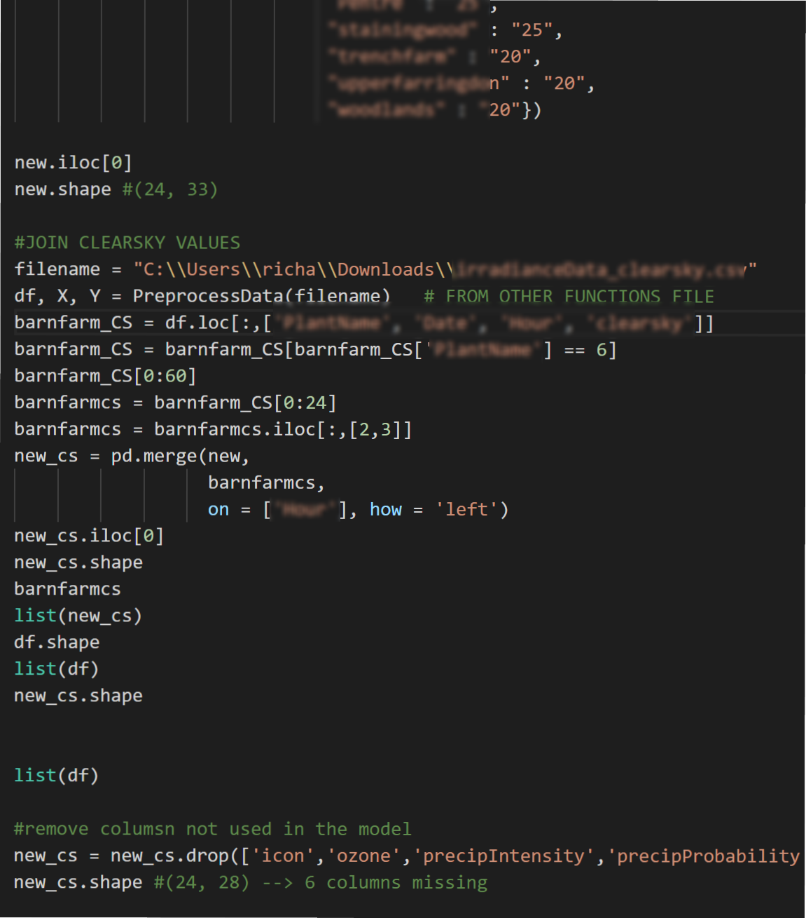
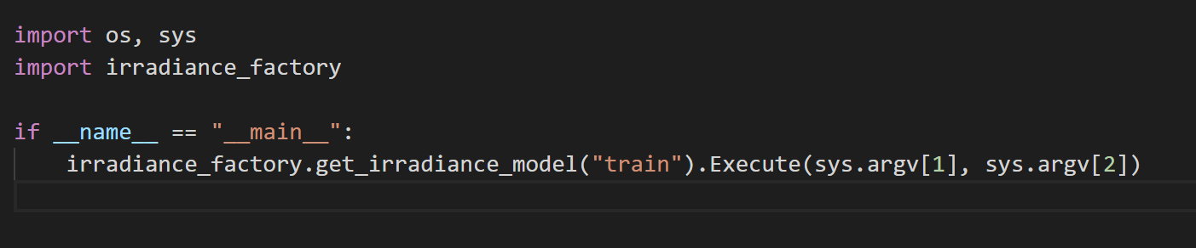
Software + Data Science

Slide 39
Do I have a problem that requires Data Science?
Is my problem clearly defined?
Can I see whether it’s been done before (Google search)?
Speak to the BI team first and see whether it’s a problem that’s been solved inside the business
If this is clearly a problem which requires a Data Scientist, spike it out before committing
Colleague of mine says, most organisations can’t do BI properly but now they’re moving onto AI
Get your data strategy right!

Slide 40
A real job ad for a Data Scientist!
Java, R, Python, F# … (bonus: Clojure, Haskell, Scala)
Hadoop, HDFS & MapReduce… (bonus: Spark, Storm)
HBase, Pig & Hive… (bonus: Shark, Impala, Cascalog)
ETL, Webscrapers, Flume, Sqoop… (bonus: Hume)
SQL, RDBMS, DW, OLAP…
Knime, Weka, RapidMiner…(bonus: SciPy, NumPy, scikit-learn, pandas)
D3.js, Gephi, ggplot2, Tableau, Flare, Shiny…
SPSS, Matlab, SAS…
NoSQL, Mongo DB, Couchbase, Cassandra…
And Yes! … MS-Excel: the most used, most underrated DS tool

Slide 41
With inefficiencies shown in red
Java, R, Python, F# … (bonus: Clojure, Haskell, Scala)
Hadoop, HDFS & MapReduce… (bonus: Spark, Storm)
HBase, Pig & Hive… (bonus: Shark, Impala, Cascalog)
ETL, Webscrapers, Flume, Sqoop… (bonus: Hume)
SQL, RDBMS, DW, OLAP…
Knime, Weka, RapidMiner…(bonus: SciPy, NumPy, scikit-learn, pandas)
D3.js, Gephi, ggplot2, Tableau, Flare, Shiny…
SPSS, Matlab, SAS…
NoSQL, Mongo DB, Couchbase, Cassandra…
And Yes! … MS-Excel: the most used, most underrated DS tool

Slide 42
How do I know if it’s working?
Revenue up, cost down!
Isolate the effect, build forecasts and trends on the model and it’s effect into the future
Build channels across the business to enhance behavioural effects around churn and Recommendations
Present back to the stakeholders regularly
Don’t decouple them from sprint retrospectives and show and tells

Slide 43
Case Study; ACME.com

Slide 44
Project Stakeholder View
Data Science Head: The CNN and hidden markov chains allow us accurate best next steps for all customers and our graph db allows us to map Euclidian distances between shoppers.
Head of Analytics: There is a reluctance of the wider company to use our amazing insights
CIO: The Data Science team outputs need aligning to business priorities and in the next FY will have a new liaison role
CMO: How do I lower my acquisition cost or reduce my customer churn?

Slide 45
Deeper Engineering View
Years to build a Recommendation Engineer
Improvements in models come in annual cycles
No dedicated KPIs which show that Recommendations are improving sales
Data quality issues, hacks in production, no version control of trained datasets
Version control and deployment outside of organizational deployment on GitHub

Slide 46
What next for ACME.com?
Elastacloud engaged to transform their stakeholder engagement
Business Outcomes from AI the primary objective
Lean Analytics and CRISP-DM
Data Science team focused and augmented with our team
3 months return on investment;
“Elastacloud has made Data Science pay off for ACME.com” - CEO

Slide 47
Thanks! Q & A
Nottingham@elastacloud.com
andy@elastacloud.com
@andyelastacloud

